Slide 1

RESTful API Design
Design pricipals, demo example implementation

Slide 2

AS-IS
Connectors
AXL
CUCM
Standard Provisioning
Frontend
REST
Backend
REST
Unity
LDAP
Active Directory

Slide 3
TO-BE (many REST, but not the same...)
Connectors
AXL
CUCM
...
Standard Provisioning
Frontend
REST
Backend
REST
Unity
...
LDAP
Active Directory
...
RESTful
APAS
...
RESTful
...
...
RESTful

Slide 4
Why REST?
Lightweight
Simple to use
Standardized operations such as add, delete, and modify
Independent of OS and programming language

Slide 5
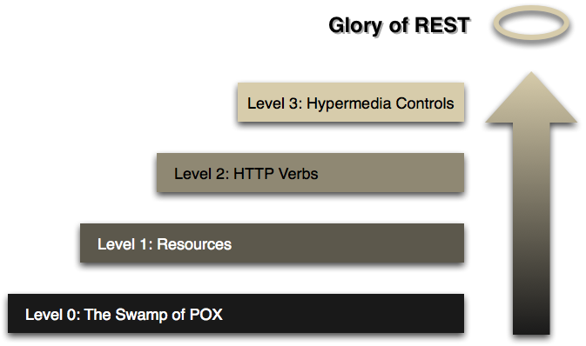
RESTful Maturity Model

Slide 6
#1 – Resources
REST level 1: Resources
Examples:
myrest/1/managers
myrest/1/assistants
myrest/1/manager/2
myrest/1/assistant/5

Slide 7












Demo Scenario

Slide 8
#2 – HTTP Verbs
REST level 2: HTTP Verbs
GET, POST, PUT, DELETE
Other useful operations
PATCH (partial update)
HEAD (get without body)
OPTIONS (what are the accapted verbs?)
LINK, UNLINK
Safe operations / Idempotent operations
Operation | GET | POST | PUT | DELETE | PATCH | HEAD | OPTIONS
Safe | ✓ | ✗ | ✗ | ✗ | ✗ | ✓ | ✓
Idempotent | ✓ | ✗ | ✓ | ✓ | ✓ | ✓ | ✓

Slide 9
#2 – HTTP Verbs
Header
Accept : application/xml
Accept : application/json
XML drawbacks
Additional annotations for JAXB:
@XmlRootElement
@XmlAttribute
@XmlElement
Element or attribute?
Empty default constructor required
Wrapper for returning lists required

Slide 10
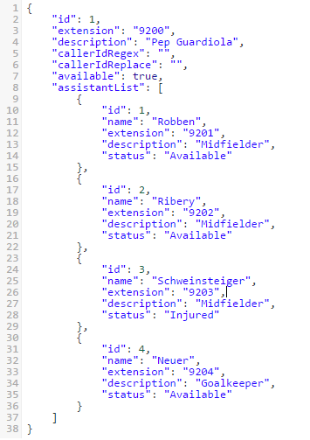
#2 – HTTP Verbs
/myrest/v2/manager/1
Manager resource
What is the id? (id, name, extension?)
Looks like an Assistant resource?
What is the relation between manager and assistant?
How to nevigate to assistants?
myrest/v2/manager/2/assistants
myrest/v2/assistants/?manager=1
Level 2 answers:
User Documentation
WADL (SOAP-WSDL style architecture)
Example:
Cisco UNITY CUPI
Level 2+ („fake” hypermedia conrols)

Slide 11
#3 – Hypermedia controls
HATEOAS
Hypermedia As The Engine Of Application State
The client does not know have built-in knowledge of how to navigate/manipulate the model
Instead server provides that dynamically: as paylod meta-data
Media types and Link Relations
Client descrtibe what it wants to have with Accept header
Server (and client during PUT, POST) describes what is in the body with Content-Type header

Slide 12
#3 – Hypermedia controls
Roy Thomas Fielding („founder of REST”)
„I am getting frustrated by the number of people calling any HTTP-based interface a REST API. REST APIs must be hypertext-driven”
„A REST API should never have “typed” resources that are significant to the client. The only types that are significant to a client are the current representation’s media type and standardized relation names.”
“A REST API must not define fixed resource names or hierarchies (an obvious coupling of client and server). Servers must have the freedom to control their own namespace.”
The client should know about only one URI, the entry point (bookmark) URI. All other navigation should be discovered while interacting with the API. Navigation information is well conveyed using link entities, like this in XML: <link rel ="users" href="http://127.0.0.1:8080/users" /> or this in JSON: { "rel" : "users", "href" : "http://127.0.0.1:8080/users" }.

Slide 13
#3 – Hypermedia controls
Central to Spring HATEOAS is the concept of a org.springframework.hateoas.Resource – which is a wrapper for a response payload and navigation links that apply to that payload
Competing formats for resource representation:
Spring HATEOAS own representation
HAL – Hypermedia Application Language
Siren
Collection+JSON

Slide 14
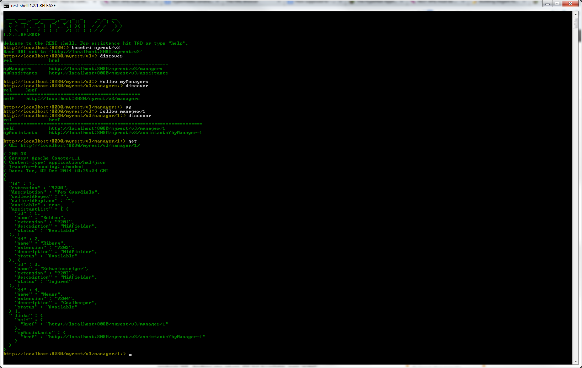
#3 – Hypermedia controls
Demonstrate HATEOAS link relations using rest-shell

Slide 15
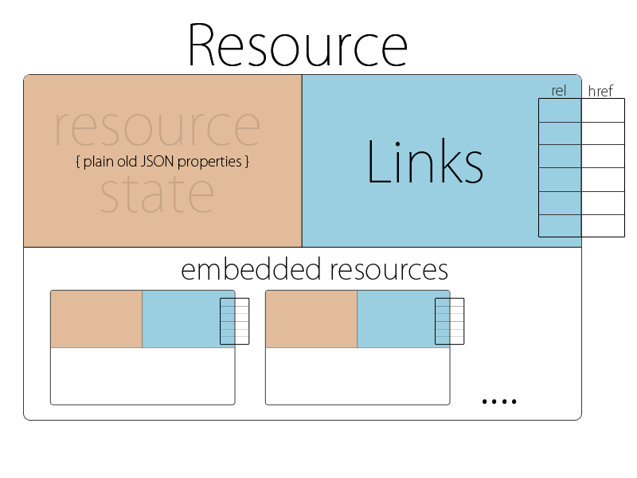
#3 – HAL specification
HAL http://stateless.co/hal_specification.html
Resource + Links +Embedded resource
+ HAL Browser
+ Minor documentation support (via CURIEs)
External examples:
#1 http://haltalk.herokuapp.com/explorer/browser.html#/
#2 https://api-sandbox.foxycart.com/hal-browser/hal_browser.html#/
#3 https://api.clarify.io/docs

Slide 16
References
Github
https://github.com/istibekesi/my-restful-api
Various Spring modules
Spring MVC
Spring HATEOAS
Spring Boot
Spring Loaded
POSTman – REST plugin for Chrome
Rest-shell: https://github.com/spring-projects/rest-shell
HAL Browser: https://github.com/mikekelly/hal-browser

Slide 17
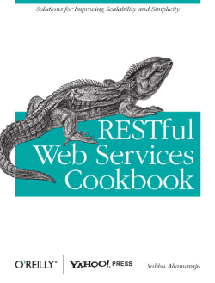
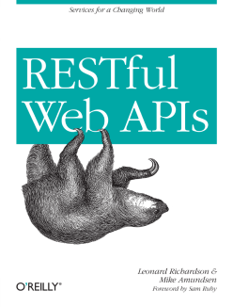
References
Books:
RESTful Web Apps Leonard Richardson and Mike Amundsen
RESTful Web Services Cookbook Subbu Allamaraju
Usefull Links
http://martinfowler.com/articles/richardsonMaturityModel.html
https://blog.safaribooksonline.com/2013/09/30/rest-hypermedia/
Recommended youtube presentation
REST-ful API Design with Spring – presented by Ben Hale
http://youtu.be/oG2rotiGr90

